Slide 1
Node JS Basic

Slide 2
Definitions
Originally written by Ryan Dahl back in 2009.
Open source development platform for executing JavaScript code server-side.
Node JS applications are event-based and run asynchronously.
It’s built on the open source Google Chrome V8 JavaScript engine.

Slide 3
Package Manager NPM
Introduced in January 2010.
Default package manager for Node JS.
Ease programmers to publish and share their libraries.
Documentation available on https://docs.npmjs.com/
Example of npm console commands:
init
install
update
uninstall
config

Slide 4
init- NPM Console Command
Creates package.json file to setup a new or existing package.
Usage example:
npm init
npm init –y

Slide 5
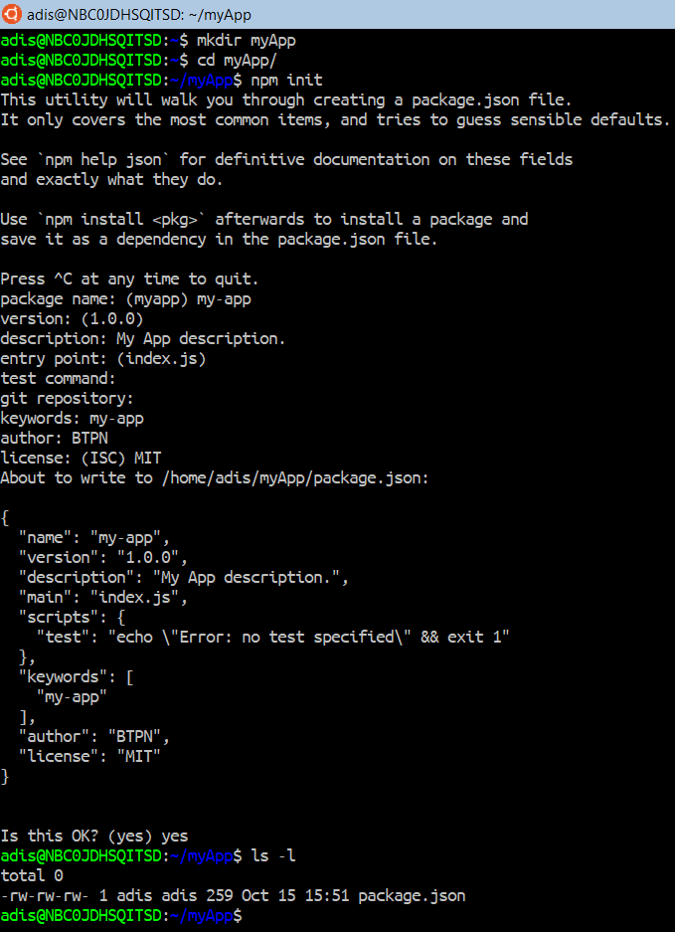
init – Usage Example
Picture on the left is the output generated when the npm init command is executed.
You will be asked to provide several information, such as:
Package name
Version
Description
Entry point
Test command
Git repository
Keywords
Author
License
All above arguments are optional.
If you’re lazy to provide such information, use this command instead:
npm init –y

Slide 6
config – NPM Console Command
Update and edit the contents of the user and global npmrc files.
npm gets its config settings from:
Command line.
Environment variables.
.npmrc file.
In some cases, package.json file.
Example usage:
List config variables: npm config list
Set / update config: npm config set <key> <value>
Delete config: npm config delete <key>
Get single config value: npm config get <key>

Slide 7
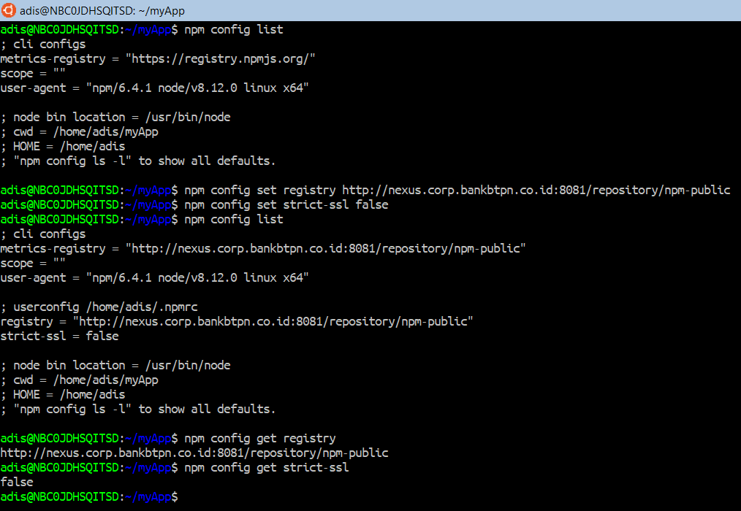
config – Usage Example
These steps will enable you to install npm package from inside TPDAYA network.
List default npm config values using: npm config list
Update the default npm registry using: npm config set registry http://nexus.corp.bankbtpn.co.id:8081/repository/npm-public
Update default npm strict-ssl value to false, using: npm config set strict-ssl false
Verify the values have been updated, by using the same command: npm config list

Slide 8
install – NPM Console Command
Installs a package, and any packages that it depends on.
Usage example:
npm install express --save
npm install nodemon --save-dev
Shorthand:
npm i express --save
npm i nodemon --save-dev

Slide 9
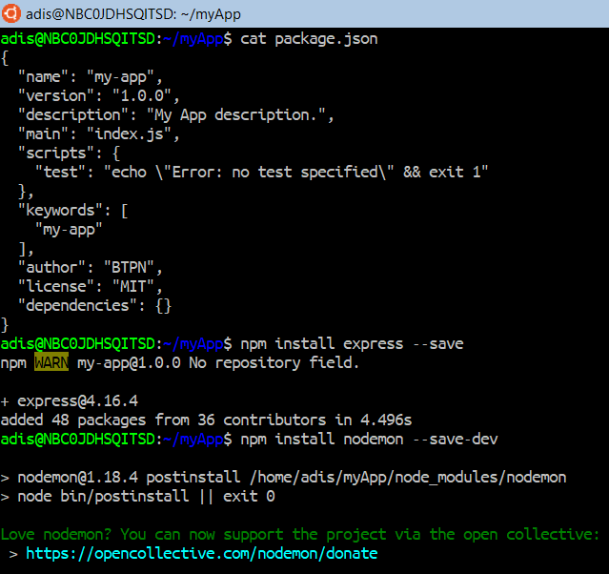
install – Usage Example
These steps will installs express and nodemon package to your current project.
First let’s view your package.json file in the editor. It should look the same as in the left picture.
Install express package with command:
npm install express --save
Install nodemon package with command:
npm install nodemon --save-dev
Check your package.json again to ensure that those packages have been added.

Slide 10
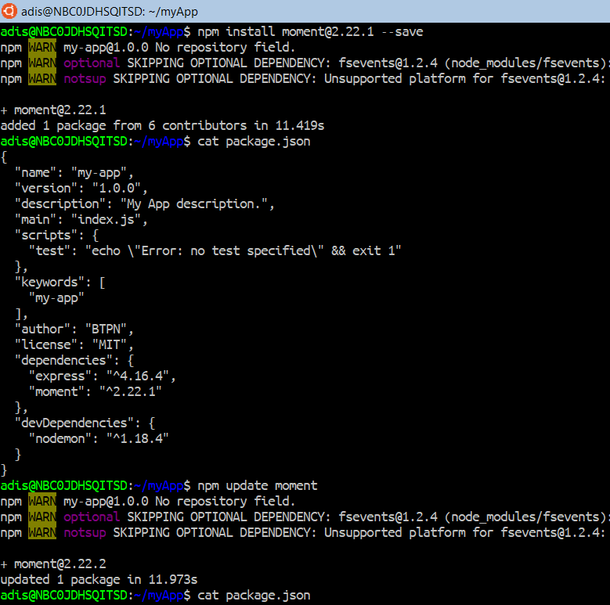
update – Usage Example
The following steps will guide you on how to install and update a package.
Install a sample package:
moment@2.22.1
Verify the package has been installed in your package.json
Update this package using command:
npm update moment
Verify again in your package.json file, that moment package has been updated.

Slide 11
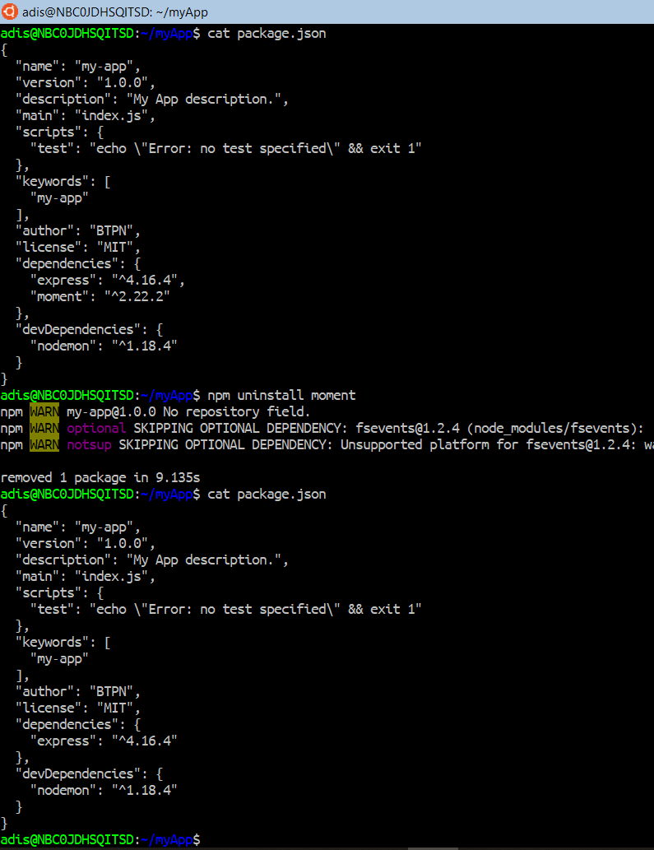
uninstall – Usage Example
The following steps will guide you to uninstall a package.
To uninstall a package, use command:
npm uninstall moment
Verify that moment package has been uninstalled.

Slide 12
Express JS Basic

Slide 13
Express JS
Originally written by TJ. Holowaychuk on 2010
Web application framework for Node JS.
Designed for building web applications and APIs.

Slide 14
Your First API
In the next section you will learn how to create simple API.
This API will implements HTTP GET, POST, PUT, and DELETE request method.

Slide 15
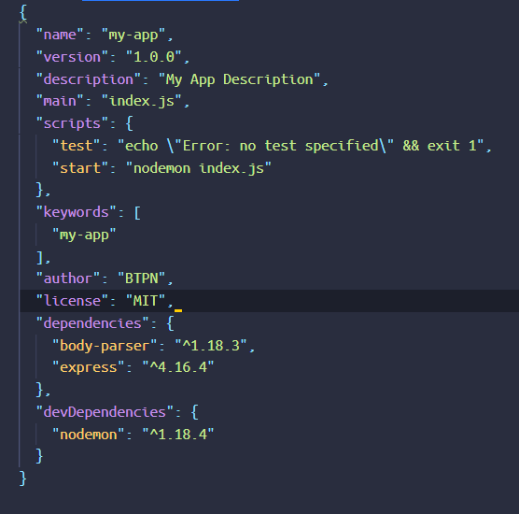
Preparations
Open your Visual Studio Code, open folder myApp.
Open your package.json file, add the following script after “test”:
“start”: “nodemon index.js”
Install new package dependency body-parser by using npm install command.
Verify that the package.json file looks the same as picture on the left.
Make sure that you have installed postman app.

Slide 16
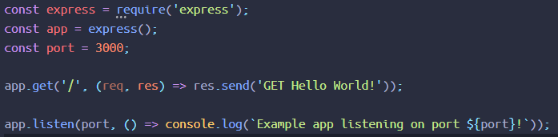
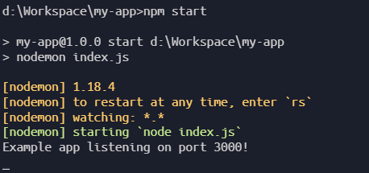
HTTP Request GET
The HTTP request GET is often used to retrieve list of data or a single data based on the parameter.
Open or create new file index.js
Write code like the example on left.
Run the code using
npm start
Open your postman app.
Type http://localhost:3000 into url input field beside the GET button.
You will see response:
GET Hello World!

Slide 17
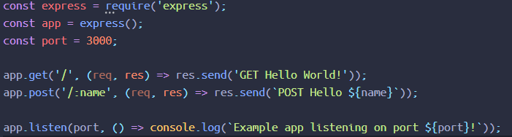
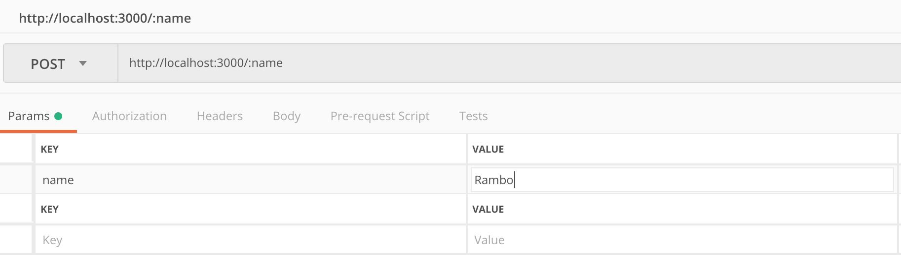
HTTP Request POST
Move on to the next endpoint. This POST endpoint is commonly used to create new data.
This endpoint will receive parameter :name and will be displayed on response.
Add new script after the app.get('/') endpoint just like you see on the picture.
Open your postman app again and switch to POST HTTP request from the button.
Update the URL, add /:name parameter.
Try typing your name on the params tab, in the value input field.

Slide 18
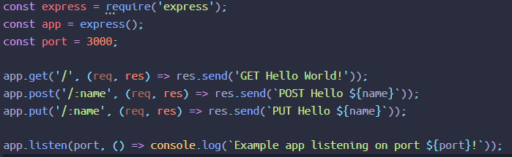
HTTP Request PUT
HTTP request PUT is commonly used to save changes to the existing data, in this example follow the same steps as described in the previous how to handle POST request.
Add new script after the app.post('/:name') endpoint just like you see on the picture.
Open your postman app again and switch to PUT HTTP request from the button.
SEND the request.

Slide 19
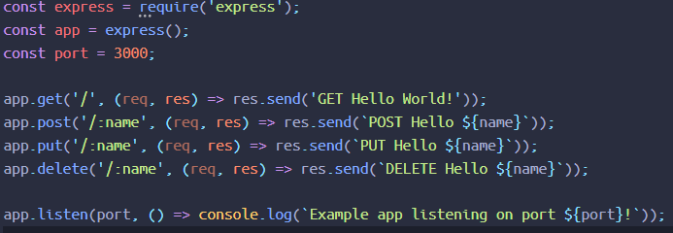
HTTP Request DELETE
HTTP request DELEETE is commonly used to delete the existing data. To make your API capable of handling DELET request, follow the steps below.
Add new script after the app.delete('/:name') endpoint just like you see on the picture.
Open your postman app again and switch to DELETE HTTP request from the button.
SEND the request.

Slide 20
Review.
What did you learn today?
Anything new?
Was it difficult to understand?

Slide 21
Thank you

